Slide 1


Molecular Rebar(R) Solutions:
Limiting Grid Corrosion and Sulphation failures
Mohamed Sharif | National technical seminar on SME Battery Sector
*MOLECULAR REBAR® is a registered trademark of Molecular Rebar Design, LLC
Notes:
Sidney’s Talk Title and the one online: MOLECULAR REBAR® Changes Your Battery’s DNA to Enhance Performance: Products for Modifying the Active Mass Structure and Corrosion Layer
Ladies and Gentle man, I am Mohamed Sharif, ADE from Black Diamond Structures. I am absolutely delighted to be here.
Thanks to Power ON for having here
1. BDS has been presenting our products for limiting NAM sulphation in the past years but today I will be presenting the same plus will be introducing our new products for limiting positive corrosion

Slide 2



Who We Are
Black Diamond Structures™ is a global nanotechnology leader with the mission to help manufacturers create the next generation of world-class batteries.
Our unique products, based on proprietary MOLECULAR REBAR® technology, together with our team of world-class nanomaterial experts alter your battery’s “DNA”, unlocking its full potential… fast.
Our teams work directly with our customers to find solutions that enhance your battery’s mechanical and electrochemical properties to meet market challenges for decades to come.
YOUR
Our Joint-Venture Partners
Notes:
We want to be your connection to the exciting world of nanotechnology

Slide 3
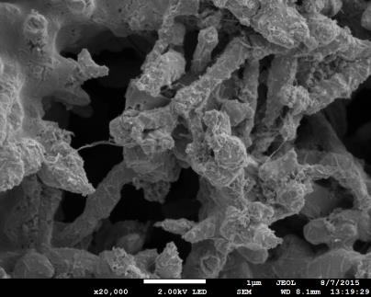
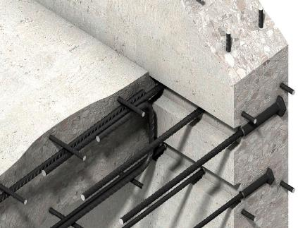
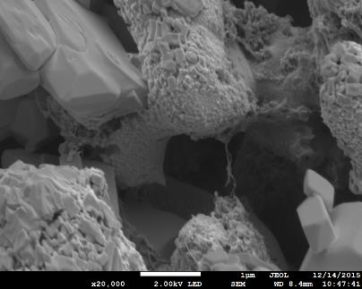
Molecular Rebar®: The Nano-Connector
Molecular Rebar products provide nanoscale reinforcements which:
Act to bring the active material together, reinforcing plate structure → Enhanced robustness
Alter crystal packing to enhance surface area and modify pore structure → Improved electrical performance
Restrict the growth of large, insulating lead sulfate crystals → Consistency of performance
Molecular Rebar Products Change the “DNA” of Your Battery
3
Notes:
Read slide

Slide 4
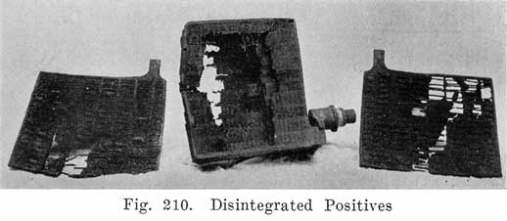
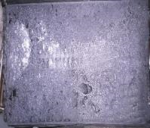
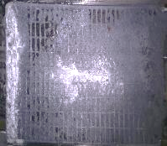
Molecular Rebar®: Solution to Lead acid battery problems
Positive plate corrosion
Corrosion is unavoidable and fundamentally required for Lead-acid battery function, Controlling it has always been a challenge
Made more difficult by higher operational temperatures in the engine compartment
Major problem in Automotive batteries
Negative plate sulphation
Evolves from idle condition of negative plates such as long storage, deficit charging and non-uniform active material utilization
Sulfated surface having large insulative Sulphate crystals causes capacity loss
Major problem in deep cycle application such as E-rickshaw and Solar; unable to charge quick leads to sulphation
A Witte. The Automobile Storage Battery; Its Care and Repair. Ford Model A Manual 1922
Negative plates of E-rickshaw after life cycle test
Notes:
Read Slide

Slide 5
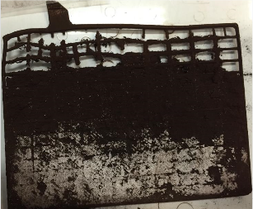
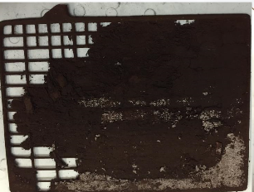
Molecular Rebar®: Successful Against Corrosion
CONTROL
Failure Mode = NAM sulfation, Positive Plate Corrosion
Previous Molecular Rebar PAM products:
Commercially adopted mostly in Deep Cycle and AGM/VRLA applications
Some anti-corrosion properties are seen in Automotive and Flooded
BDS required better understanding to develop a targeted product:
Tailored our DNA-changing technology to focus on corrosion mitigation
Explored our own mechanism of action, using it to drive product development
Performed joint-development work on formation and curing impacts
Targeted cost-to-value of any new solution
INTRODUCING PbAC SERIES OF PRODUCTS!
Pb2300N + Pb2300P
Life Cycle Improvement = +150%
Notes:
We have been using MR products in the past years – commercially adopted in AGM/VRLA batteries.
Some anti-corrosion properties seen in Auto and flooded
Lantian 35Ah, Internal – 60% DoD cycling, less corrosion at top of plate

Slide 6


Mechanism of Corrosion
Acid attacking the grid
Corrosion Layer (CL) is built during curing/forming and is the 1st line of defense against further damage
Defects and gradual wear of CL allow acid access to alloy
Releases alloy components to PAM/NAM; weakens the grid and active mass
Escaping metals aggravate gassing, ex. Sb poisoning
Field Conditions that Exacerbate Corrosion:
Temperature
Over-charge
Over-voltage
CL
CL
Acid
Alloy Components
Notes:
This is the mechanism of corrosion as we understand.

Slide 7




Our Approach: Build An Improved Corrosion Barrier
CURED
FORMED/CYCLED
New PbAC Products are designed to modify the Corrosion Layer to improve plate robustness
PbAC technology changes cured PAM “DNA”
Uniformly affects the active material
KEY TO ENABLEMENT
Discrete, uniformly distributed MR
During formation, PbAC is a sacrificial agent
Initially, energy goes to PbO/PbSO₄ and MR oxidation
Tempers energy delivery to system
A lasting effect on Corrosion Layer after formation
Thinner, denser, more uniform
Improved Grid-to-Mass Adhesion
Changes persists through life
Shield grid from acid to prolong life
CONTROL
Acid
Alloy Components
Molecular Rebar
PbAC Series
Notes:
Increased surface/pore area (BET, MIP, EIS)
Altered pore structure
More tortuous acid path to the grid
Increased plate strength during mechanical testing
“tempers energy” = lower voltage in some cases in first couple hours (hypothesis = MR burning off, current goes into MR degradation and Pb, helps to ramp up current slow)

Slide 8
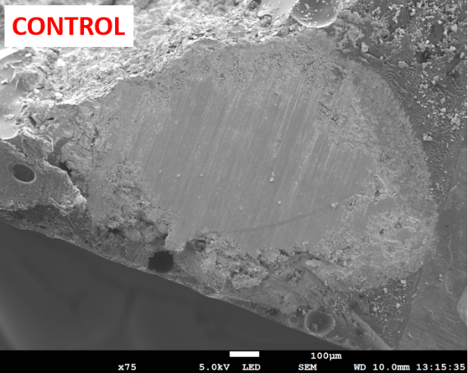
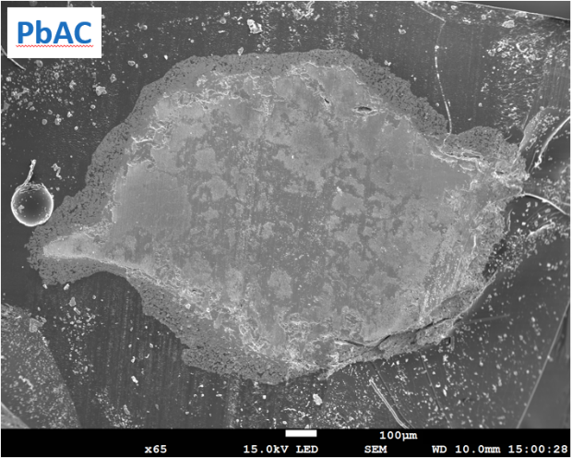

Enhanced Corrosion Layer Delays Corrosion-based Failure
Sb, Cast, J2185
PbAC generates a superior corrosion layer to improve cycle life >25% (SAE J2185 post life image below)
PbAC layer is thinner, denser, more uniform, and as a monolayer instead of a bilayer
An effect of altered acid access, improved grid/mass adhesion, likely changed electrochemistry
PbAC
CL1
CL1
CL2
(No Apparent CL2)
Notes:
This is picture of grid cross section of positive plates with and without PbAC after life cycle test.
In this life cycle test we had 25% improvement by using PbAC
CL1 forms during curing and formation – because CL1 is weaker and porous during life cycle acid penetrates through CL1 and dissolves more grid
More corrosion happens in the grid causes grid thinning and eventually grid breakage
When PbAC used it creates more thinner, denser more uniform layer it limits acid access to grid protects grid like a shield – reduce corrosion related failures, improves life

Slide 9
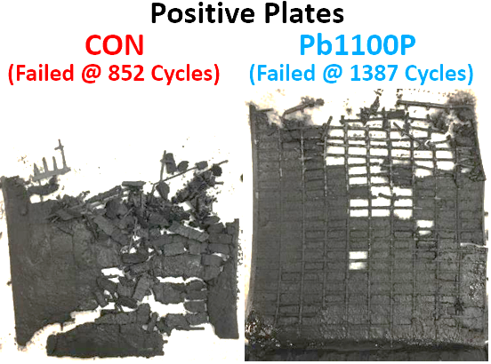
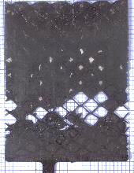
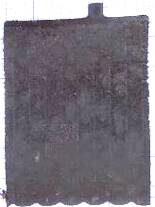
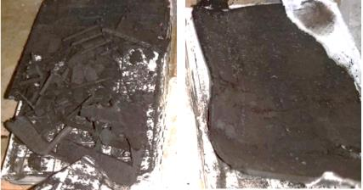
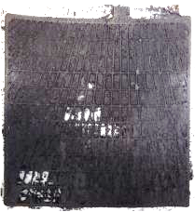
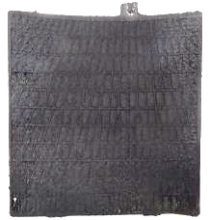


Dramatic Improvements Seen in Full-scale Testing
Sb, Cast
Ca, Expanded
SAE J240 Cycling (75 ºC)
60% improvement using PbAC to delay corrosion
JIS D5301 Cycling (41 ºC)
PbAC delays positive plate corrosion, material loss
Implementation of PbAC results in an enhanced Corrosion Layer
This new corrosion layer protects grid from further degradation and improves battery life where corrosion is the main failure
Effects confirmed with:
Grid Alloys
Ca/Sn, Ca, Sb
Grid Types
Cast, Expanded, Punched
…and counting!!
CONTROL
PbAC
CONTROL
PbAC
Ca/Sn, Cast
Sb, Cast
JIS D5302 Cycling (45 ºC)
100% improvement using PbAC to delay corrosion
SAE J2185 Cycling (50 ºC)
PbAC delayed corrosion and acid decolorization
CONTROL
PbAC
CONTROL
PbAC
Acid Sample:
Acid Sample:
Notes:
PBL 32Ah – J240 testing
Panasonic, 32Ah, Internal – D5301 cycling
Ko Motors – ABNT 15941 / JIS D5302 cycling
Enerya – 2185 cycling

Slide 10
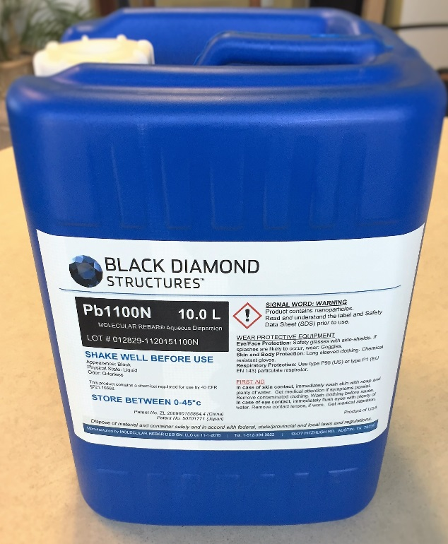
PbAC Series Usage
Usage of 10L PbAC100 in 1000Kg positive oxide:
PbAC Products are designed to modify the Corrosion Layer to improve plate robustness
Improves battery life where corrosion is the main failure mode
Personal Car , Three Wheeler – Taxi sector
Commercial Vehicle battery
E-rickshaw flat positive battery
PbAC100

Slide 11



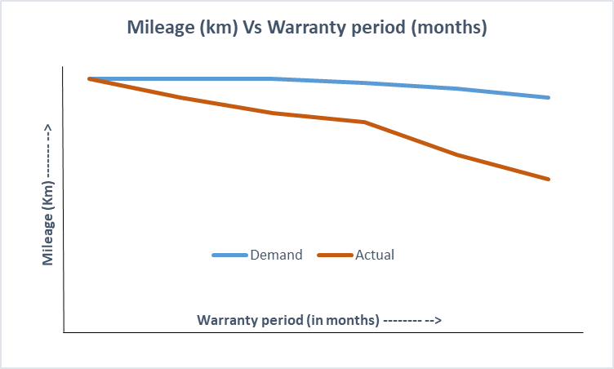
Negative plate Sulphation : E-rickshaw battery performance gap
Negative active material Sulphation and Bulging believed to be the trigger of all other failure modes occurring in an E-rickshaw battery
Source : Independent Study conducted by BDS
Notes:
Evolves from idle condition of negative plates such as long storage, deficit charging and non-uniform active material utilization
Sulfated surface having large insulative Sulphate crystals causes capacity loss
Major problem in deep cycle application such as E-rickshaw and Solar; unable to charge quick leads to sulphation

Slide 12

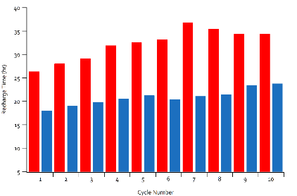
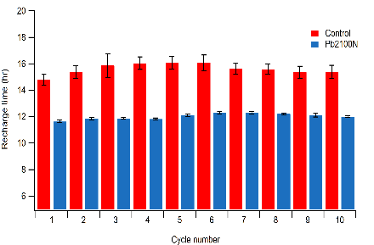
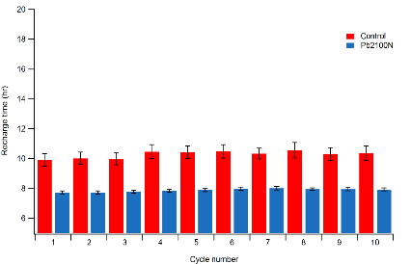
Molecular Rebar® Impact on E-rickshaw battery performance
Key Features:
Enable Flat Plate recharge times in Tubular
Delayed need for day-time charging
Reduced water consumption
Extended Cycle Life
More Consistent Capacity throughout Life
Note
Axis
Scale
15 A/14.4 V
10 A/15.2 V
15 A/15.2V
Control
Pb2100N
Control
Pb2100N
Av. CON = 32.3 h
Av. MR = 20.9 h
Av. CON = 15.6 h
Av. MR = 12.0 h
Av. CON = 10.2 h
Av. MR = 7.9 h

Slide 13

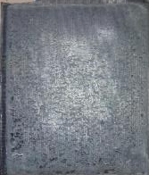
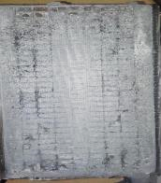
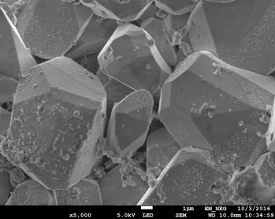
Molecular Rebar® Impact on E-rickshaw battery performance
Control Negative
Molecular Rebar® Negative
Non-uniform material utilization
Material soft and puffing/falling out
Heavily sulfated surface
Large insulative Sulphate crystals
Shiny surface, plate still usable
No sulfate present on surface
Smaller and uniformly sized crystals
Molecular Rebar® increases the utilization of the Pb already in the plates
Notes:
Because of these features MR avoid formation of sulphation in negative plate –
You can see different color zones indicating non-uniform material utilization

Slide 14

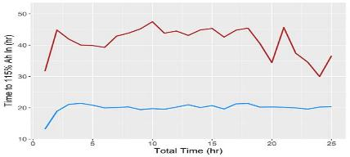
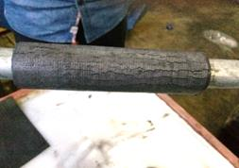
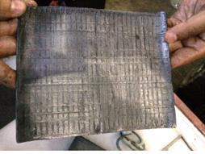
Pb2100 Series Tubular e-Rickshaw: Customer Success Story #1
“ Finally, we made a perfect e-rickshaw battery” – Customer
Lab Testing: 50% Reduction in Recharge Time
Recharge Time to 115% Ah Return
Customer Issue
Tubular e-rickshaw batteries produced had chronic sulphation due to poor charge acceptance
Field failures resulted in a 20% Warranty Return Rate
Manufacturer had to stop producing e-rickshaw batteries
Pb2100N as the Solution
Customer is now using 34L of Pb2100N to improve charge acceptance and suppress sulfation, providing consistent performance and dramatically extended life
Customer has launched a new line of Premium High Warranty e-rickshaw batteries into the market
Customer has also implemented Pb1100 Series for their Premium High Warranty Automotive – SLI Flooded batteries
Control
Pb2100N
Field Results: Check @ 4 Months
Bend Test
After Bend Test – MR Plate Showing High Integrity
Notes:
I would like share some of the customer success stories – on how customers are taking advantage of Molecular Rebar Products.

Slide 15
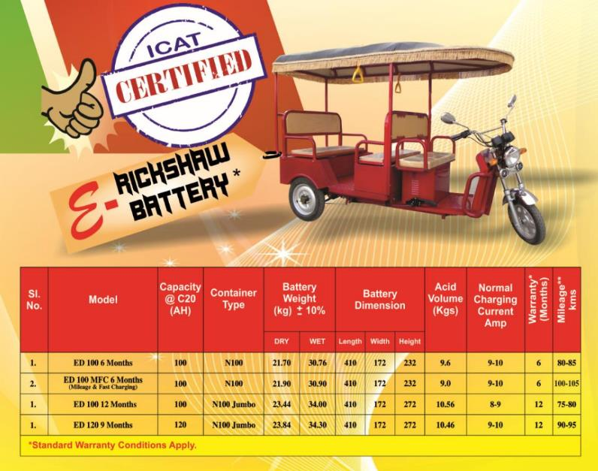

Pb2200 Series flat e-Rickshaw: Customer Success Story #2
“ An improved product for the market capture” – Customer
Customer Issue
Flat plate batteries running 80-85km, charging 9-10hrs – heavy competition on this range
~3% warranty failures further affecting sales and brand value
Pb2200N as the solution
Customer is now using 30L of Pb2200N (per 1000Kg batch of oxide) to charge efficiently – providing a quick charging (7Hrs) and yield more mileage (100-105km)
Customer has launched a new line of Premium batteries with high mileage (100-105km) / quick charging (7hrs) / reduced Warranty failures (1%) into the market
0km
85km
105km
Notes:
The Molecular Rebar did not increase the capacity of the battery but it increased the charge acceptance – it means unlocking its full potential

Slide 16
Pb2100 Series tubular e-Rickshaw: Customer Success Story #3
“ E-rickshaw battery business is profitable now” – Customer
Customer Issue
6-7% warranty failures causing negative margins
Tubular E-rickshaw battery business produced more trouble as volume increases
Pb2100N as the solution
Customer is now using 30L of Pb2100N (per 1000Kg batch of oxide) that helps suppress the common failure modes such as capacity loss due to sulphation
Giving great confidence to customer as the returns are drastically reduced (below 2%) – increasing the volume of business
Application | Rickshaws in testing | No. of batteries in testing | Given Warranty | Performance/ No. of months running | Batteries returned | % Warranty return
ER-Tubular | 3 | 15 | 06 months | 16 months | 0 | 0.00
ER-Tubular | 24 | 120 | 06 months | 09 month | 2 | 1.60
ER-Tubular | 176 | 880 | 06 months | 08 months | 2 | 0.22

Slide 17
Maximize Benefits By Working Together
New Product Release: PbAC Series for Corrosion Resistance
Improves the corrosion layer to protect the grid and enhance life in corrosion-limited applications
Easy adoption, no capital expense, application-development teams available to assist in implementation
BDS uses a collaborative approach and our Application Development Teams stand ready to support you
Cost reduction and/or performance improvements accessible with existing Molecular Rebar products:
Pb1100 Series – Light and Heavy Duty SLI
Pb1200 Series – Enhanced Flooded Batteries
Pb2x00 Series – Deep Cycle (Flooded and VRLA)
… and many more!!
The Collaborative BDS Approach:
BDS works closely with the customers to jointly assess the performance gaps and recommends loading, implementation considerations.
Provides on-site support through out the process

Slide 18
